Slide 1
Systems Virtual College WMLA overview and Hands on Lab
Dustin Van Stee - WW Client Experience Centers - Data Scientist / Quantum Ambassador, IBM Systems
vanstee@us.ibm.com
Kelvin Lui – Sr. Technical Product Manager, Watson Machine Learning Accelerator
kelvinl@ca.ibm.com

Slide 2
Agenda
WMLA Overview and Resources
WMLA Administration Walk Through
DLI Image Classification
HPO Jupyter Notebook Lab
EDT Notebook walk through

Slide 3
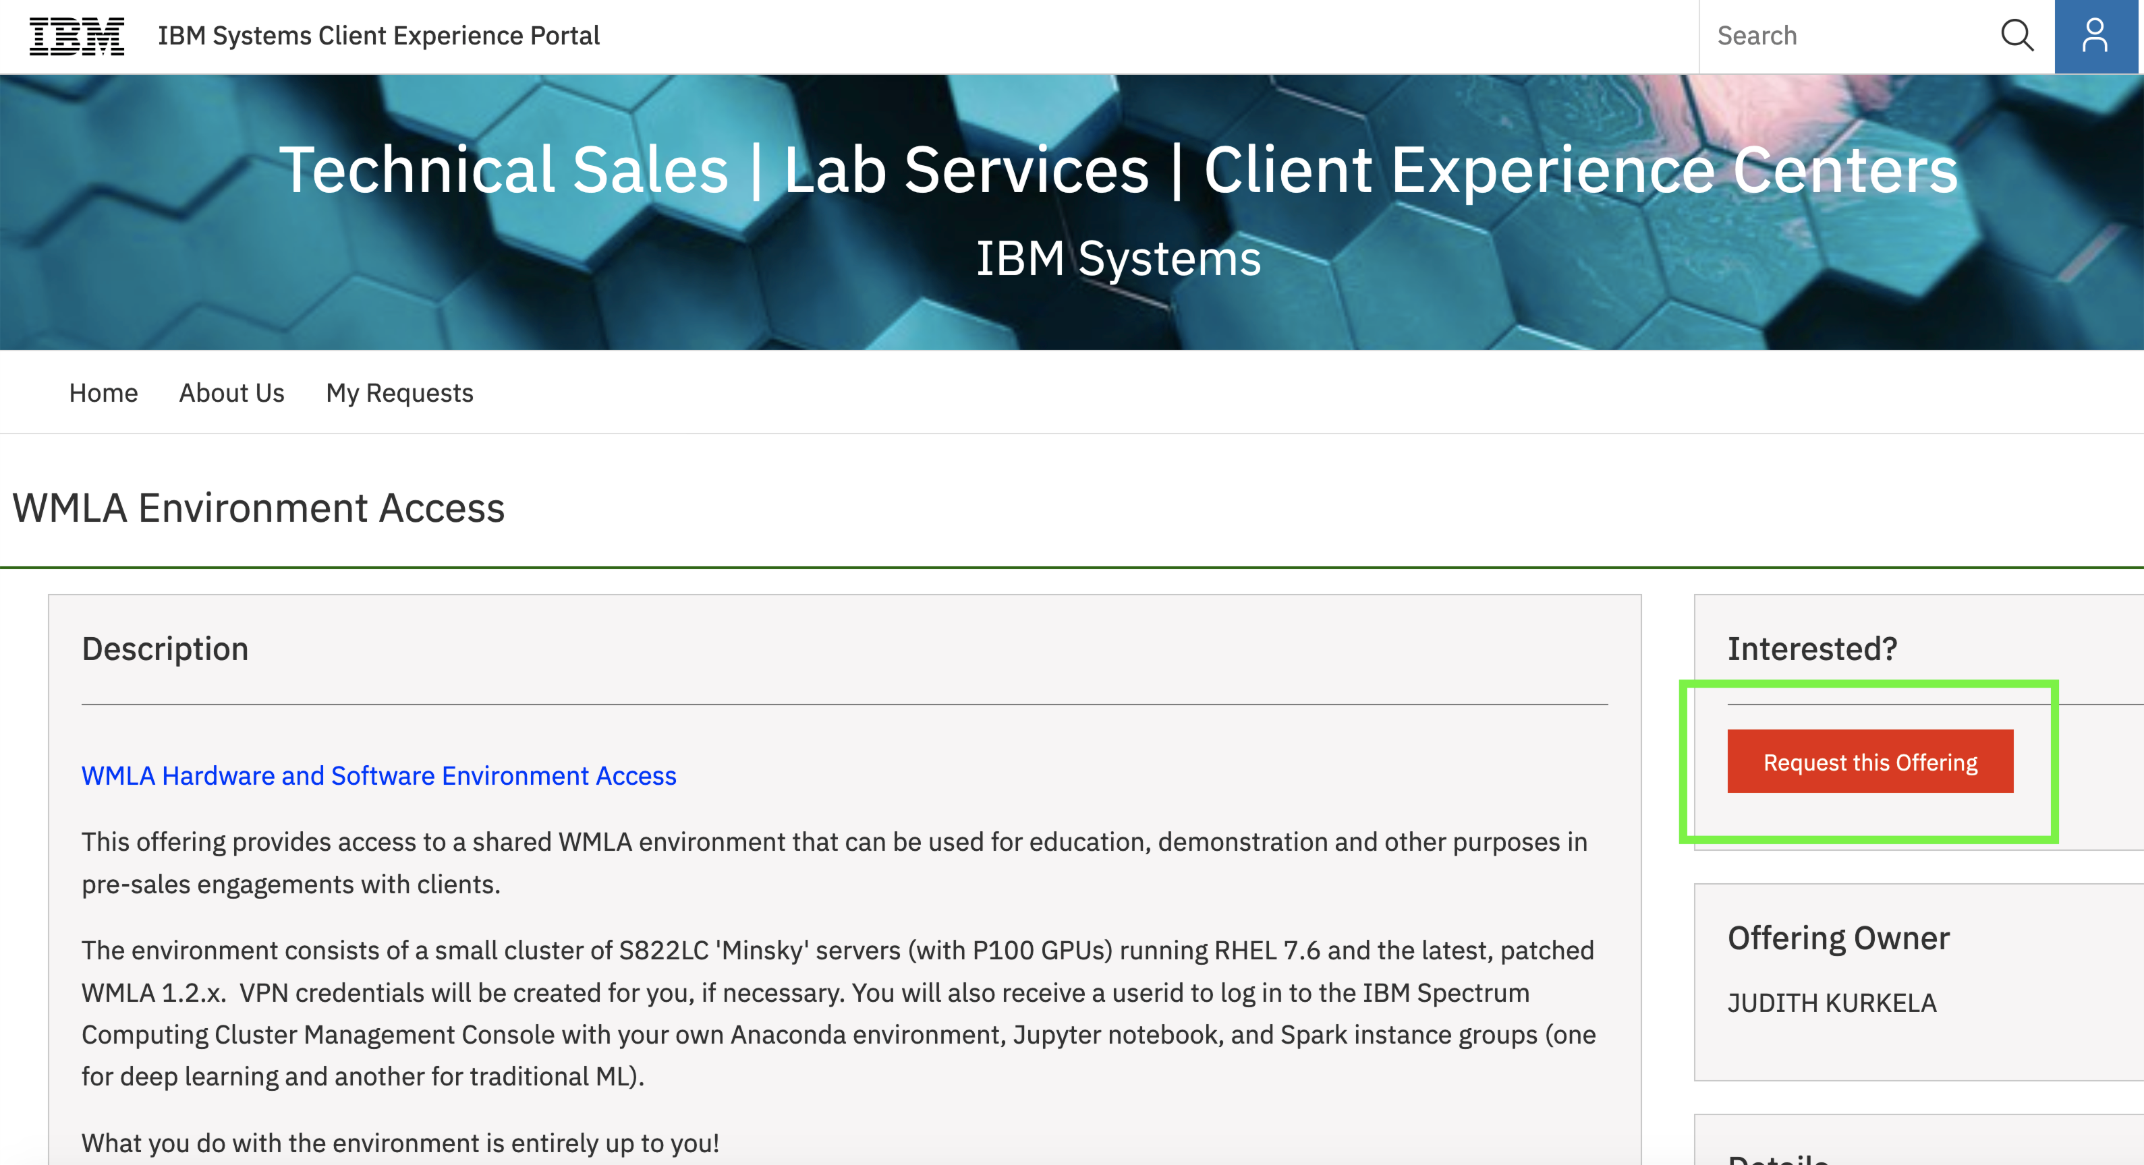
IBM System Client Experience (ISCEP) offering
Shared WMLA environment for education, demonstration and other purposes in pre-sales engagements with clients.
ibm.biz/wmla-iscep

Slide 4
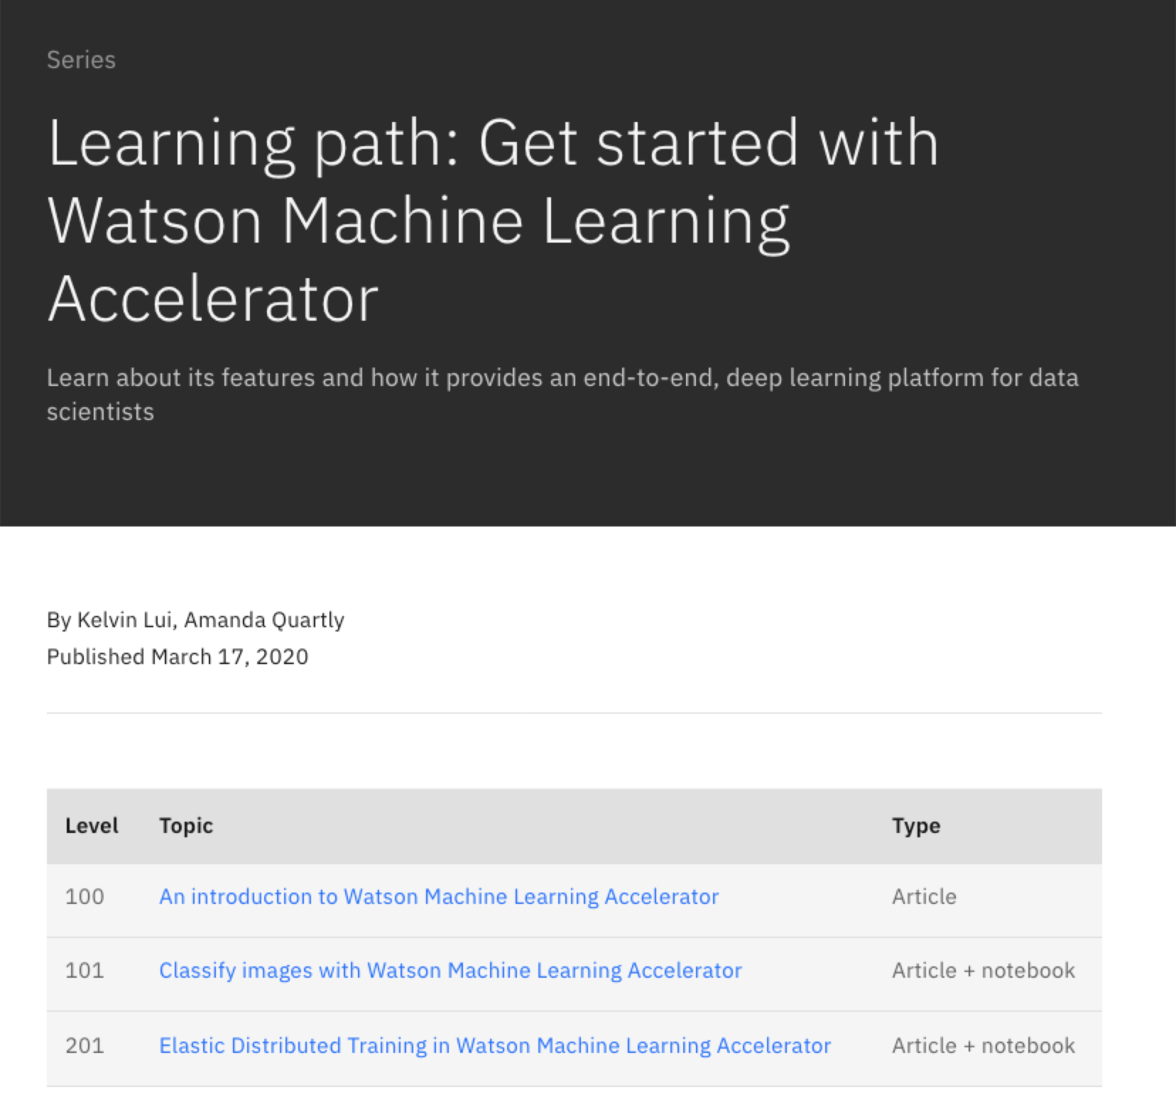
Watson ML Accelerator Learning Path
Cohesive learning experience offers an insight of Watson ML Accelerator
Self-pace module offers hands on e2e experience with WML A key features
Regular update with new learning module
Ibm.biz/wmla-learning-path

Slide 5
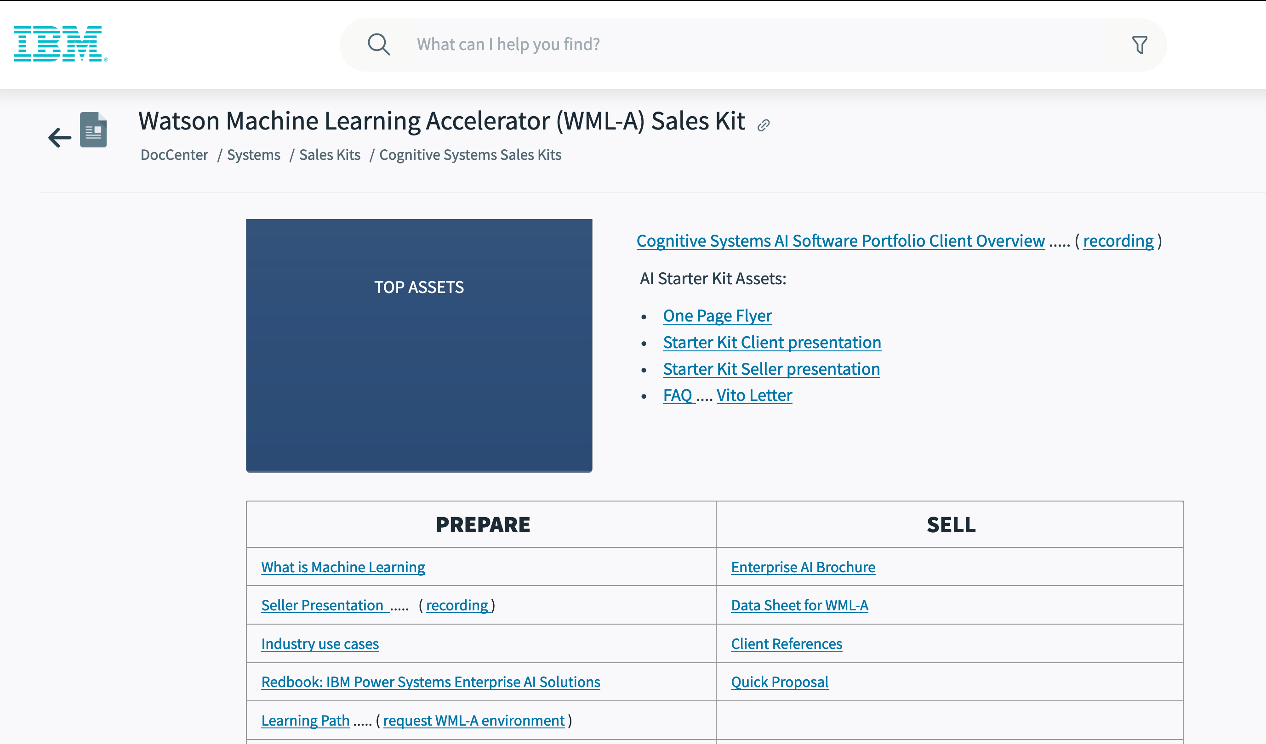
WMLA Seismic DocCenter
Assets for supporting sales conversation and client engagement
ibm.biz/wmla-seismic

Slide 6

AI as a Dynamically, Scalable Enterprise Service Accelerating Results across the Data Science Workflow
Machine / Deep Learning, R, Python Workloads
In-house & Other Applications
Operationalize AI across Data, Train, Inference lifecycle
Consolidate Analytics, AI Application Silos into one common platform
Common Scheduler for Spark, Machine learning, Python, SAS, Home-Grown & Other Applications
Replaces “Yarn” with Conductor/WMLA for managing Spark, Hadoop workloads
Multi-Tenant (multiple jobs on same server)
Efficient Resource Sharing, especially expensive resources like GPUs
Hybrid Multi-cloud : enable bursting into the cloud
SnapML
Watson ML Accelerator
with Spectrum Conductor
REDHAT OPENSHIFT
(KUBERNETES)
Bare Metal
(Hadoop, Spark)
Racks of Data, Training and Inference servers
(x86 & Power)
6

Slide 7
What’s New in Watson ML Accelerator V1.2.2 – May 29th
Incorporates all prior fixes into a single package refresh for ease of installation
With upgrade path from WMLA 1.2.1 to WMLA 1.2.2
Based on WML CE 1.7.0 with latest frameworks including SnapML
New “Watson ML Accelerator – Inference” chargeable component for inference only servers, featuring elastic distributed inference
Certification of IBM Power IC922 for training and inference
Readiness for integration test with WS/WML in CP4D 3.0 June release
Coming in 2H:
Full data-train-inference offering on Openshift and Kubernetes

Slide 8
Basic Workflow for ML/DL Training & Execution
New Data
Data Source
Data Preparation
Model Training
Inference
Traditional Business Data
Data Ingestion
Parallel Hyper-Parameter Search & Optimization
Elastic Distributed Inference (REST API)
Heavy IO
Monitor & Advise
Sensor Data
Pre-Processing
Deploy and Run Trained Models in Production at Scale
Network Models
Hyper- Parameters
Data from collaboration partners
Iterate
Training Dataset
AI Deep Learning Frameworks
(Tensorflow, Caffe, …)
Instrumentation
Data from mobile apps & social media
Testing Dataset
Legacy Data
Distributed & Elastic Training for Deep Learning
Multi-Tenant, Shared Services Architecture
Resource Groups, Consumers, Resource Plans, Instance Groups, Resiliency,
Workload Management, Notebooks, Anaconda, Reporting, Security

Slide 9
What’s New in Watson ML Accelerator V1.2.2
Incorporates all prior fixes into a single package refresh for ease of installation
With upgrade path from WMLA 1.2.1 to WMLA 1.2.2
Based on WML CE 1.7.0 with latest frameworks including SnapML
New “Watson ML Accelerator – Inference” chargeable component for inference only servers, featuring elastic distributed inference
Certification of IBM Power IC922 for training and inference
Readiness for integration test with WS/WML in CP4D 3.0 June release
Coming in 2H:
Full data-train-inference offering on Openshift and Kubernetes

Slide 10











Multitenancy at Scale – Shared Services Architecture
Physical view Single cluster of resources managed by IBM PowerAI Enterprise
Logical view Each group has their own cluster resources – Isolated & Secured with SLA Managed Resource Allocation
Instance Group #1
Administrator
LOB
Instance Group #4
IT or Data
Warehouse
Marketing…
Fraud Detection…
Instance Group #2
Linux
Linux
Linux
Linux
Linux
Linux
Linux
Linux
Linux
ETL / Batch
Data scientist
Linux
Linux
Linux
Linux
Linux
Linux
Linux
Linux
Linux
Linux
Linux
Linux
Linux
Linux
Linux
Linux
Linux
Linux
Instance Group#5
Linux
Linux
Linux
Compute Nodes
LOB
Instance Group #3
Researcher
IOT
x86 Systems
HPC
HDFS
Spectrum Scale
Cloud Object Storage (COS)

Slide 11
How it works / some terminology...
Group A
Group B
Users / Roles
Users / Roles
...
Instance Groups
Instance Groups
Consumers
Consumers
Resource Plan / Policy
Maps consumers to shared resources
Mgmt
Tasks
CPU
GPU
Resource Groups
Servers / Nodes

Slide 12
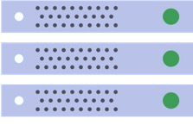
Auto Hyperparameter Tuning with WML Accelerator
Data scientists run 100s of jobs with different hyperparameters
Learning rate, Decay rate, Batch size, Optimizers (GradientDescent, Adadelta, Momentum, RMSProp, …)
Auto-Tuner searches for good hyperparameters by launching 10s of jobs in parallel with 10,000s of iterations and selecting the best ones
4 search algorithms: Random, Tree-based Parzen Estimator (TPE), Bayesian, Hyperband
Bring Your Own Algorithm
WML Accelerator Auto-Tuner
Data
Job 1
Monitor & Prune
Select Best Hyperparameters
Job 2
DNN Model
Job n
IBM WML Accelerator
GPU-Accelerated Power and x86 Servers
Notes:
Before the training process begins, data scientist can spend tremendous amount of time and generally take brute force approach to try different combination of hyper-parameters associated with the model and dataset. This iterative tuning process could take up to days, weeks or even months.
Watson ML Accelerator Auto Hyper-parameter Tuning feature helps reducing the number of experimental iterations and accelerate arriving at the optimal parameters. It automates hyper-parameter search with defined ranges of searching space and running these searches in parallel across available resources in the cluster, with Data Scientist's choice of search algorithm including Random, Tree-based Parzen Estimator, Bayesian or Hyperband, or even bringing in their own Algorithm. The search engine returns the most promising combination of hyper-parameters to the data scientist.
Afterwards, data scientists can kick off training with the optimal values of hyperparameters found during this automated tuning.

Slide 13
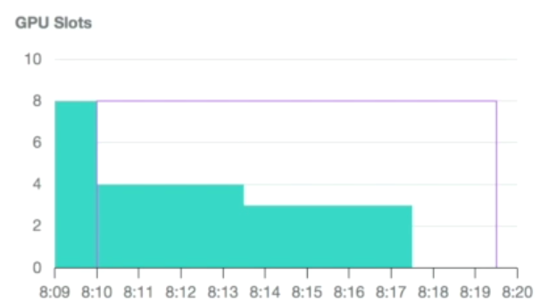
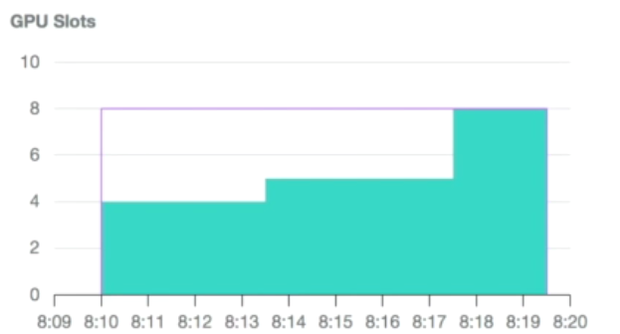
Elastic Distributed Training Transparent, Elastic, Resilient
Job #1
Environment
Two (2) POWER8 servers with four (4) GPUs
Eight (8) GPUs total
Policies
Fair share
Preemption
Priority
Timeline
T0 - Job 1 starts, uses all available GPUs
T1 - Job 2 starts, Job 1 gives up four GPUs
T2 - Job 2 priority change, Job 1 gives up GPUs
T3 - Job 1 finishes, Job 2 uses all GPUs
Job #2
T0
T1
T2
T3
Notes:
Watson Machine Learning Accelerator Elastic Distributed Training (EDT) simplifies the distribution of training workloads for the data scientist. The model distribution is transparent to the end user, with no need to specifically know the topology of the distribution. The usage is simple, define a maximum GPU count for training jobs, and Watson Machine Learning Accelerator schedules the jobs simultaneously on the existing cluster resources. GPU allocation for multiple jobs can grow and shrink dynamically based on fair share or priority scheduling and without interrupting running jobs.
Lets go through an example to show how EDT works. The client has eight GPUs across two servers (four GPUs per server) and there are eight data scientists within their team. Each of these data scientists is using the native distribution engine tied to the particular framework they are using (many frameworks have their own built-in distribution capabilities that allow them to scale).
As soon as the first data scientist starts their job, they would consume all eight GPUs… which means that all of the other data scientists are blocked until this first training job is complete (which could take as long as hours or days).
This then leads into scheduling by phone, where the data scientists are calling each other, trying to determine who gets to use things and when. This is an extremely inefficient way of managing these shared resources. And at any moment, somebody will be starving for these resources and will be non-productive.
Now with EDT providing fair share scheduling and priority based scheduling, which allows for pre-emption and reclaim of GPUs without killing a job.
This means that you can start a job asking for eight GPUs and since it’s the first job running it will take all eight available GPUs in the cluster. This is represented by time T0 in the graphs. At time T1, a second job starts and also wants eight GPUs. Instead of this job failing to start and the data scientist calling up the owner of the first job to see if that job can be killed, a redistribution of resources takes place. Here, the fair sharing policy will pre-empt four GPUs from the first job and give them to the second job, and they both execute in parallel (with neither one being killed).
Let’s then say that it’s determined that the second job is more important – or needs to be given more resources – than the first job. In this case, the priority of the second job is raised (time T2) and in doing so the first job gives up a GPU and it’s given to the second job on the fly (the prioritization is ratio-based). Again, this is all done without killing any of these running jobs.
And finally, when the first job finishes (time T3), the second job can start consuming all eight GPUs.
The effect of this is twofold. First, this is keeping both data scientists productive. Second, this is maximizing usage of the resources at all times. This comes from that ability to dynamically move GPUs from one workload to another without killing jobs.
You no longer have situations where unused or under-utilized resources are “trapped” in a server that nobody has access to (or has to be reserved in anticipation of a coming workload), or where all of the resources are consumed by a single job with everybody else queued up behind it.
This type of technology is key to being able to support a multi-tenant, shared services architecture because you need this fair sharing, pre-emption reclaim capability in order to do that effectively – and this is EDT capability is unique to WML-A.

Slide 14
Elastic Distributed Training Scaling Efficiency
Dynamically scales hosts and GPUs to meet demands for AI applications based on SLA
No disruption to running workloads during scale up/down
Excellent 94% scaling efficiency demonstrated from 6 to 48 GPU

